Slide 1
Depressed Detective
MLDA-EEE Hackathon
PyGuis
Bai Yuanqing
Fu Xiaoxuan
Kuo Lun-Hsin
Shalina Sham @ Lim Shana
Srey Ponhvoan
Tan Rui Bin
Video Link: https://youtu.be/LHZeXcXwLTY

Slide 2

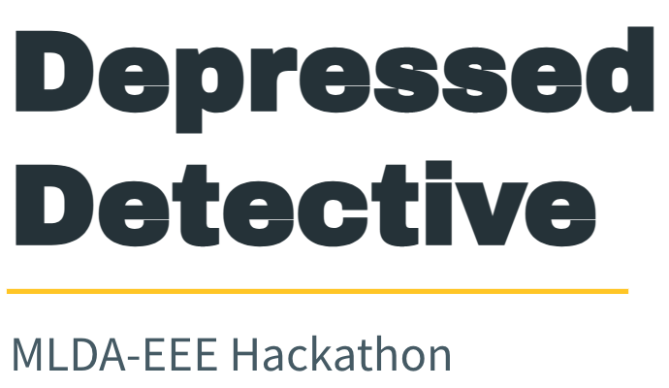
What is Depressed Detective?
A means to help managers detect workers facing burnout, especially in today’s context, where we strive towards Smart Nation.

Slide 3



Generation of Data
Real Life Data
Simulated Data
Quality Testing
Use GAN model to generate simulated data based on real life data
Test quality of generated data through PCA and t-SME plots and discriminative score
Use video and audio data to extract facial and audio features using DeepFace, which leverages Convolutional Neural Networks (CNNs), and Librosa tools
Notes:
Use real life data
Ran vid and audio data to obtain facial and audio features
Facial features extracted using DeepFace, which leverages CNNs
Audio features extracted using chroma 12 tones.

Slide 4
Logistic Regression Classifier
XGBoost Classifier
XGBoost, which stands for Extreme Gradient Boosting, is a scalable, distributed gradient-boosted decision tree (GBDT) machine learning library.
It provides parallel tree boosting and is the leading machine learning library for regression, classification, and ranking problems.
Logistic Regression is a classification technique used in machine learning when the value of the target variable is categorical in nature.
Logistic regression is most commonly used when the data in question has binary output, so when it belongs to one class or another, or is either a 0 or 1. It uses a logistic function to model the dependent variable.

Slide 5
Multilayer Perceptron (MLP) Classifier
Random Forest Classifier
Random forest, like its name implies, consists of a large number of individual decision trees that operate as an ensemble.
Each individual tree in the random forest spits out a class prediction and the class with the most votes becomes our model’s prediction
Multi layer perceptron (MLP) is a supplement of feed forward neural network.
In this network, the information moves in only one direction—forward—from the input nodes, through the hidden nodes (if any) and to the output nodes.
It consists of three types of layers—the input layer, output layer and hidden layer.

Slide 6
Summary of Results
From our various models, we observe that accuracy are high for all.
Nonetheless, we argue that the logistic regression serves our purpose the best, because it presents the most sensible R² and MSE.
In theory, the deep learning methods, such as the MLP, and XGBoost, show very optimistic results, even with the test data, suggesting that overfitting is not a problem.
However, in our opinion, perhaps they are too ideal to be true. Therefore, we have chosen to err on the safe side and decide to go with the humble logistic regression which seems more realistic.

Slide 7
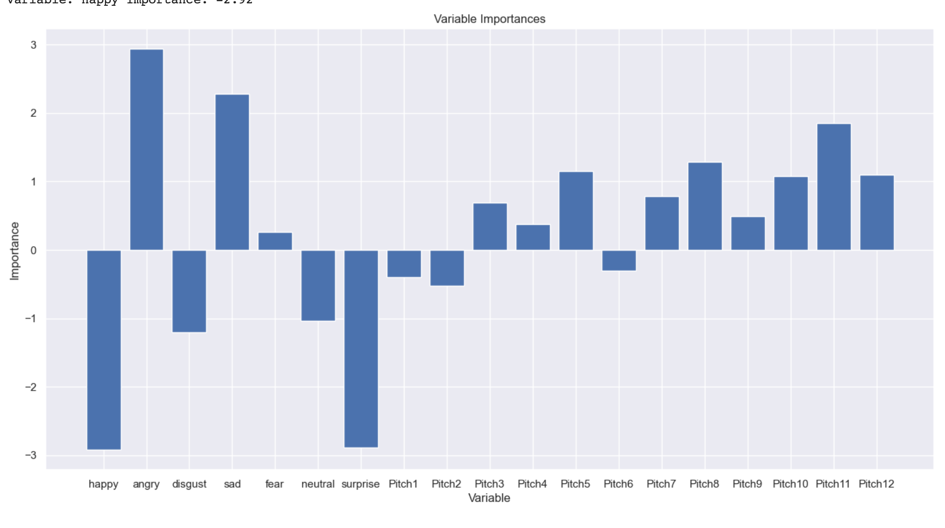
Notes:
A more positive importance indicates a higher likelihood of depression.

Slide 8
Telegram Bot
A means to centralise and display data, regulate and update managers on the employees’ emotional statuses across different time periods.
The processed data from the python script is uploaded to the Google Spreadsheet which can then be retrieved by the telegram bot

